Slide 1

Will the drive fall for the coupon or not?
Inderpreet Grang

Slide 2



Topics
Data Cleanup
Data Analysis & Visualizations
Conclusions

Slide 3

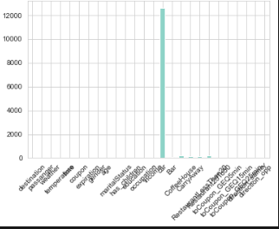
Data Cleanup
Data clean up is a very important step in any data mining project.
First step we did was to add up total number of N/A cells in each column. There were 12684 rows in original data set.
car 12576
Bar 107
CoffeeHouse 217
CarryAway 151
RestaurantLessThan20 130
Restaurant20To50 189
We decided to drop the N/A rows for all except car column (since car column is basically sparse). This ended up with 12079 data rows

Slide 4
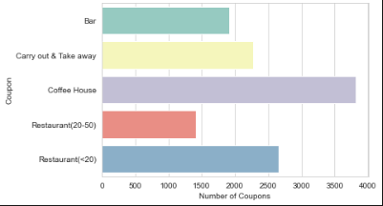
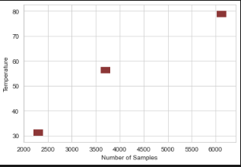
Data Analysis & Visualizations
Here is a bar plot of the coupon types. The project analyzed the Bar coupon. In the second section, we picked up the “Carry Out & Take Away” coupon and analyzed the coupon.
Observations:
Coffee House has most number of coupons
Expensive restaurants has least number coupons
Most instances were in 80’s deg range and least were in 30’s deg range

Slide 5
Data Analysis & Visualizations (Bar coupons)
Observations:
Mean temp for bar coupons was 57.6.
42% of drivers had children and mean score of drivers saying yes was 41%. Perhaps if we had sent coupon more focusing on ones without children
78.9% were going in opposite direction when coupon was sent and 66% cases the coupon bar was within 15min of drive time from drive current location.
There were substantial number of drivers driving with kids when coupon was sent. Only 20% of those drivers accepted the coupon. We could have improved our acceptance if we didn’t send to drivers with kids. In contrast there were ~57% of drivers with friends accepted the coupon
There was 51.070637557348526% more chance of bar coupon getting accepted for those who went to bar more than 3 times than those who went 3 or less
There are ~28% less likelihood for folks > 25 and going to bar >= 1 per month to get the coupon than those less than 25 or go < once per month and got a coupon
There is ~39% more change of those who go > 1 to bar per month and have no kid and not farmer, fisherman or forestry to get a bar coupon than others
Drivers who went more often to bar and had no kids and were > 25 years . There is also a correlation where drivers going t cheap restaurants and having less income were less prone to get coupon.

Slide 6
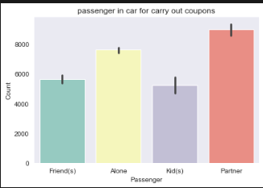
Data Analysis & Visualizations (Carry out or take away option coupons)
Observations:
73% of participants who got the carry out coupon retrieved the coupon.
There was 2.991174330319424% more chance of carryout coupon getting accepted for those who went for carry out more than 3 times than those who went less than thrice
The above is a contrast to what we saw with the bar coupons. Here it seems frequency of carry out doesn’t impact someone to get the coupon. Also the age of driver didn’t make a huge difference in coupon effectiveness.
There was 1.7357183257918574% more chance of carryout coupon getting accepted by someone less than 21 than that more than 21

Slide 7
Conclusions
There is scope to improve coupon adoption for bar coupon by sending more to drivers without kids in car or sending coupons to bar that are in same direction
Sending carryout coupons after 6PM has 9% more chance of acceptance
There is not much difference in coupon adoption for drivers less than 21 years old vs more than 21 years old
Frequency of carryout doesn’t impact rate of coupon adoption unlike in case of bar coupons
Success rate of carry out coupon adoption was 73%

